Slide 1
Asset Accounting
Mukesh Kumar
Associate SAP FICO, Vertex Consultant
Notes:
The below and following notes on the template slides are to guide you only. In your final presentation, you may delete these notes and add relevant notes if any.
Title slide:
Title – should not exceed beyond 3 lines, font size 30-34, Arial Headings
(Font size for the title of the PPT can vary between 30-34, Arial Headings, Bold depending on the amount of text, however should not be smaller than 30 font size)
Name should not exceed beyond 1 line, Designation; font size to remain at 18, Arial Headings
Please keep the title slide simple, just the logo, title and name and designation to appear. No other graphic elements or any design, photograph, image can be added to this slide, alignment to remain the same

Slide 2
Overview: Asset Accounting
Purpose
The Asset Accounting (FI-AA) component is used for managing and supervising fixed assets within the SAP System.
SAP gives up the functionality in Asset module to manage different depreciation as per the reporting requirements.
Implementation Considerations
The Asset Accounting is intended for international use in many countries, irrespective of the nature of the countries.
The Implementation Guide (IMG)provides the necessary functions for this in asset accounting.
Integration
As a result of integration in the SAP system, Asset Accounting (FI-AA) transfers data directly from other SAP components.
For example, When as asset is purchased or produced in-house, you can directly post the invoice receipt or good receipt to assets in the Asset Accounting component.

Slide 3
Overview: Asset Accounting Posting
The appropriate General Ledger accounts are updated each time you post based on the Account Determination in Asset GL Integration point.
General Ledger
Assets
Liabilities
1000
1000
Assets Account
Vendor
1000
1000

Slide 4
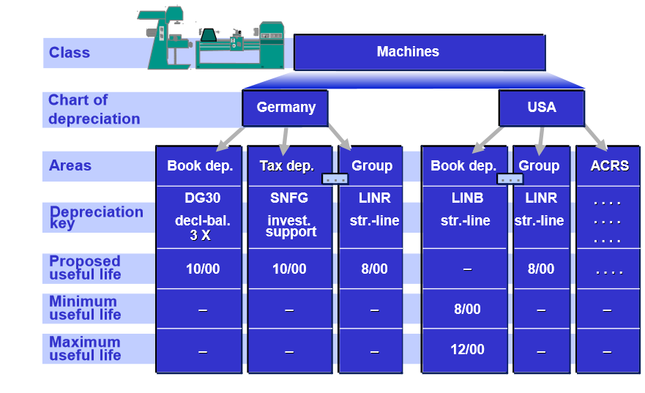
Chart of Depreciation
The chart of depreciation is a list of depreciation areas arranged according to business and legal requirements. The chart of depreciation enables you to manage all rules for the valuation of assets in a particular country or economic region.
INDIA
USA

Slide 5
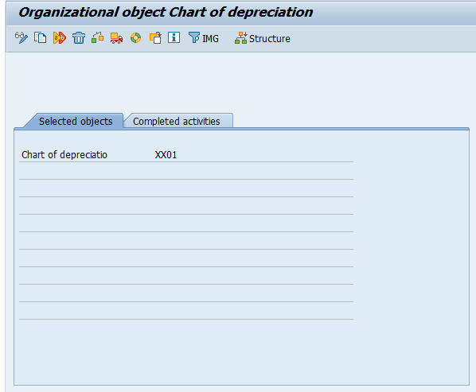
Copy Reference Chart of Depreciation
Path: IMG> Financial Accounting >Asset Accounting> Organizational Structures > Copy Reference Chart of Depreciation/Depreciation Areas

Slide 6
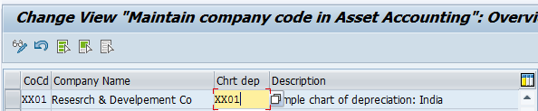
Assign Chart of Depreciation to Company Code
Path: IMG> Financial Accounting >Asset Accounting> Organizational Structures > Assign Chart of Depreciation to Company Code

Slide 7
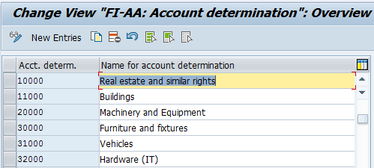
Specify Account Determination
In this step, we define the account determinations for Asset Accounting (key and description). The key of an account determination must be stored in the asset class. The G/L accounts will be posted according to the account determination in asset class.
Path: IMG> Financial Accounting> Asset Accounting > Organizational Structures > Asset Classes> Specify Account Determination

Slide 8
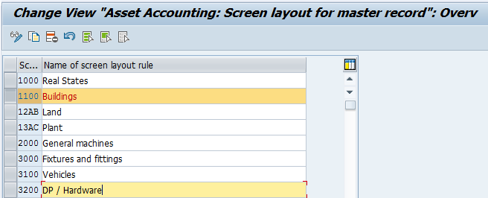
Create Screen Layout Rules
The screen layout specifies the status of the fields in the asset master record. You use the screen layout to determine if fields are required entry or optional entry fields, or if they are suppressed completely.
Path: IMG > Financial Accounting> Asset Accounting > Organizational Structures > Asset Classes> Create Screen Layout Rules

Slide 9
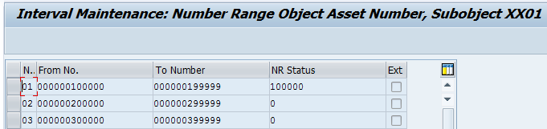
Define Number Range Interval
In this step, we define the number ranges for the company code for assigning the main asset number.
Path: IMG > Financial Accounting> Asset Accounting > Organizational Structures > Asset Classes > Define Number Range Interval

Slide 10
Asset Class
The asset class is the most important criteria for structuring fixed assets from an accounting point of view. Every asset has to be assigned to exactly one asset class.
The asset class is used to assign the assets (and their business transactions) to the correct general ledger accounts.
The asset class contains default values and control elements which are passed on to the individual assets when you open a new asset master record.
The below important specifications are controlled by asset class
Account Determination Screen Layout Control Number Range for the assignment of the asset main number

Slide 11
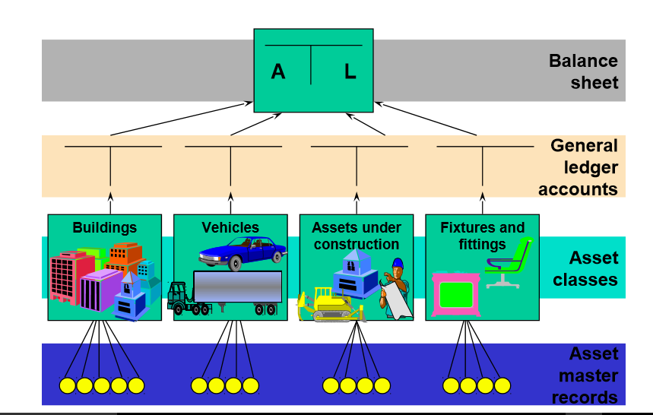
Asset Class

Slide 12
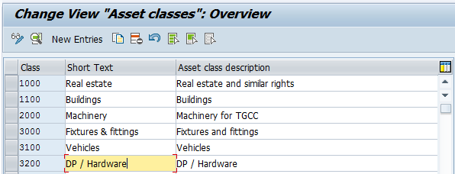
Define Asset Class
Path: IMG > Financial Accounting> Asset Accounting > Organizational Structures > Asset Classes > Define Asset Classes

Slide 13
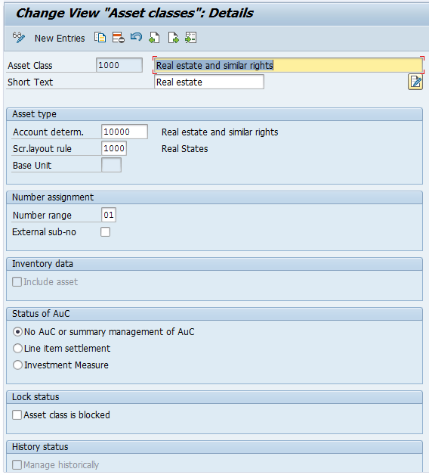
Define Asset Class

Slide 14
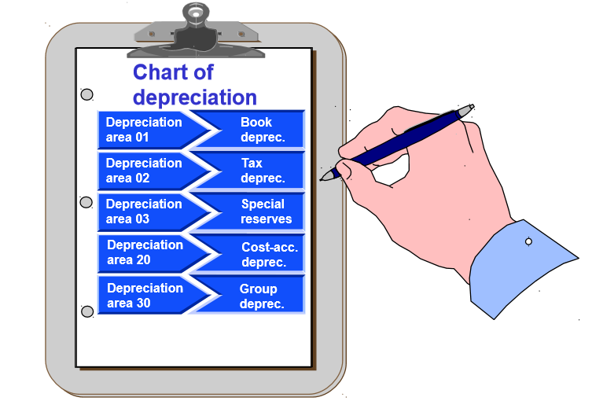
Depreciation Areas
We generally need values for fixed assets for various business and legal purposes (for example, for book depreciation, cost-accounting depreciation and so on). In the R/3 FI-AA system, it is therefore possible to manage values in parallel in as many depreciation areas as you want.

Slide 15
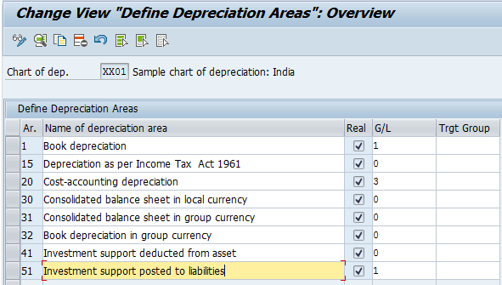
Define Depreciation Areas
Path: IMG> Financial accounting > Asset Accounting > Valuation > Depreciation Areas > Define Depreciation Areas.

Slide 16
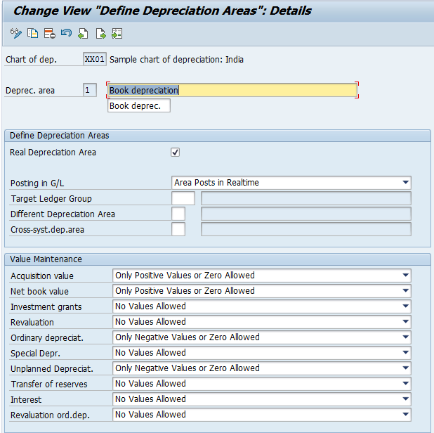
Define Depreciation Areas

Slide 17
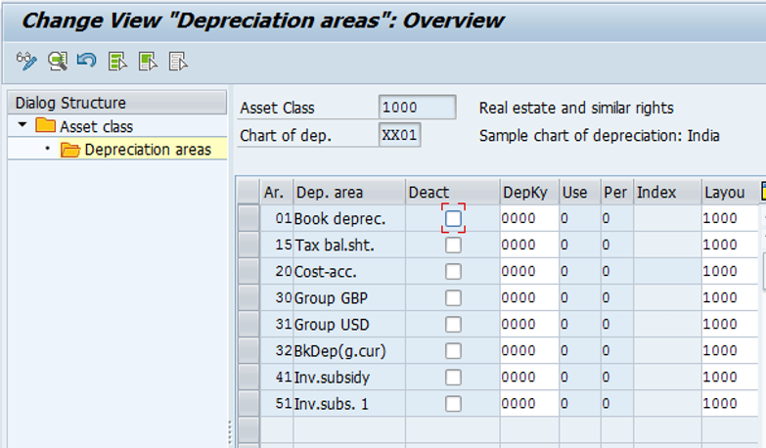
Determine Depreciation Areas in the Asset Class
Generally, the assets in an asset class use the same depreciation terms (depreciation key, useful life). Therefore, we do not have to maintain the depreciation terms in the asset master record. Instead, they can be default values from the asset class.
Path: IMG > Financial accounting > Asset Accounting > Valuation > Depreciation Areas > Determine Depreciation Areas in the Asset Class.

Slide 18

Define How Depreciation Areas Post to General Ledger
In this activity, we specify the depreciation areas that post their APC transactions and/or depreciation to the general ledger. The system posts the transactions of the depreciation areas to the general ledger online automatically.
Path: IMG > Financial Accounting> Asset Accounting > Integration with the General Ledger > Define How Depreciation Areas Post to General Ledger

Slide 19
Depreciation Key
We maintain depreciation keys by assigning calculation methods to them. You can divide the duration of depreciation into several phases. When you enter a changeover method for one of these phases, the system changes over to the next phase as soon as the event specified in the changeover method has occurred. The system then uses the depreciation calculation that is specified in the calculation method for this phase.
Below are the specifications of the Depreciation Key
We define the required depreciation keys per chart of depreciation.
Depreciation is calculated according to the depreciation key in the asset master.
The depreciation calculation method is the most important feature of the internal calculation key. It is used to carry out the different types of depreciation calculation.

Slide 20
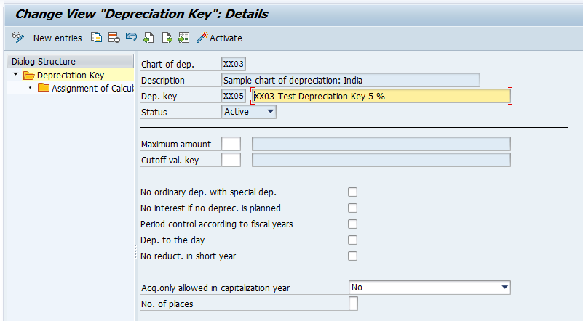
Define Depreciation Key
Path: IMG > Financial accounting > Asset Accounting > Depreciation> Valuation Methods > Depreciation Key > Maintain Depreciation Key

Slide 21
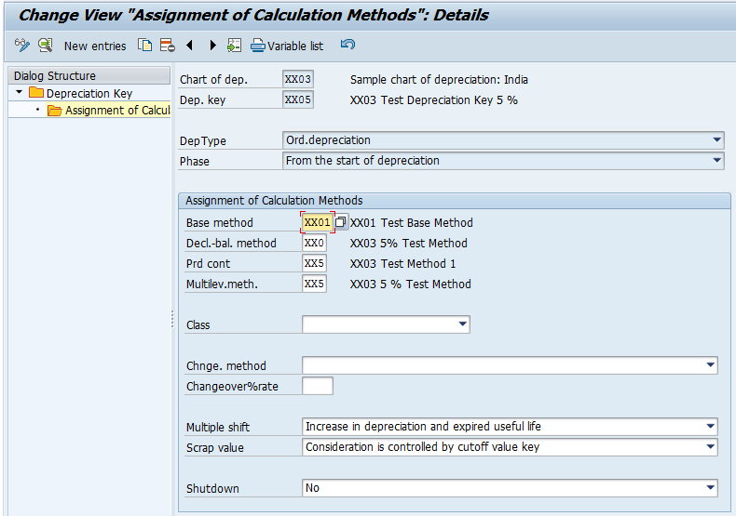
Define Depreciation Key

Slide 22
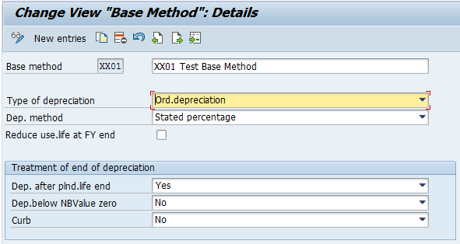
Define Base Methods
In this step, we maintain base methods. Base methods are valid in all charts of depreciation. We assign base methods to depreciation keys.
Path: IMG > Financial accounting > Asset Accounting > Depreciation> Valuation Methods > Depreciation Key > Calculation Methods > Define Base Methods

Slide 23
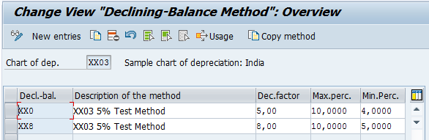
Define Declining-Balance Methods
In this method we specify the multiplication factor for determining the percentage rate of depreciation, upper limit for depreciation rate and lower limit of the depreciation rate.
Path: IMG > Financial accounting > Asset Accounting > Depreciation> Valuation Methods > Depreciation Key > Calculation Methods > Define Declining-Balance Methods

Slide 24
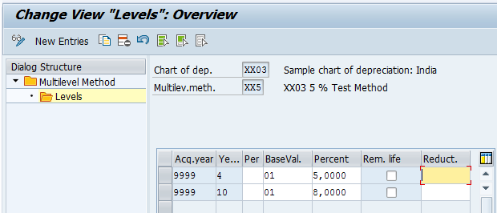
Define Multi-Level Methods
We define multi level methods and assign them to the depreciation keys. Each level represents a validity period for a given percentage rate.
Path: IMG > Financial accounting > Asset Accounting > Depreciation> Valuation Methods > Depreciation Key > Calculation Methods > Define Multi-Level Methods

Slide 25
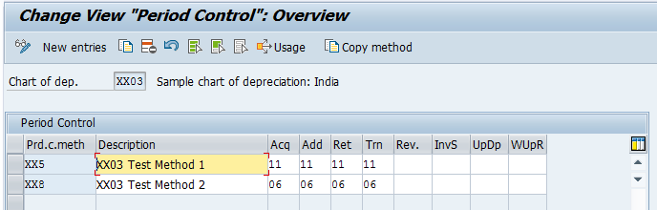
Maintain Period Control Methods
Period control methods are maintained and assigned to the respective Depreciation Keys. Period control methods can be assigned to different transaction such as Acquisitions, Subsequent Acquisitions, Retirement, Transfer etc.
Path: IMG > Financial accounting > Asset Accounting > Depreciation> Valuation Methods > Depreciation Key > Calculation Methods > Maintain Period Control Methods.

Slide 26
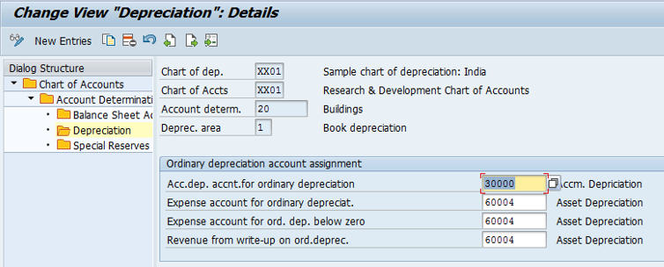
Assign G/L Accounts
We assign all the relevant G/L Accounts for Asset Accounting in this step. This is the most important configuration for Integration with General Ledger Account. Each G/L account assigned with the combination of Chart of Depreciation, Chart of Accounts, Account Determination & Depreciation area.
Path: IMG > Financial Accounting> Asset Accounting > Integration with the General Ledger > Assign G/L Accounts

Slide 27
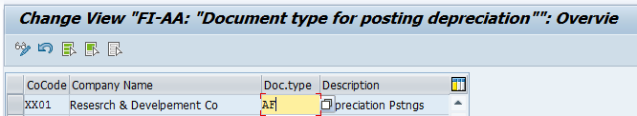
Specify Document Type for Posting of Depreciation
The Document Type posted for depreciation are defined in this step. It is mandatory to define number ranges before defining the document type for any company code
Path: IMG > Financial Accounting> Asset Accounting > Integration with the General Ledger > Post Depreciation to the General Ledger> Specify Document Type for Posting of Depreciation

Slide 28
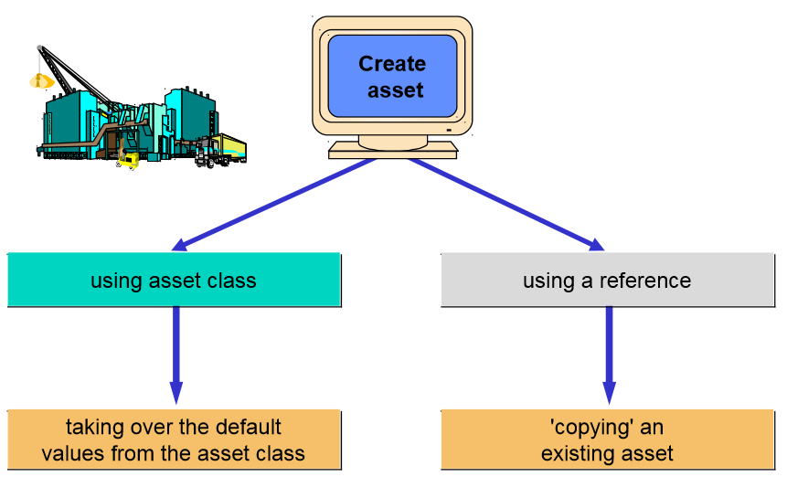
Master Data

Slide 29
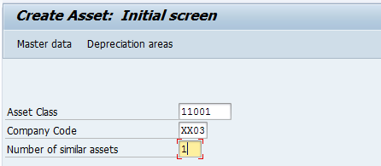
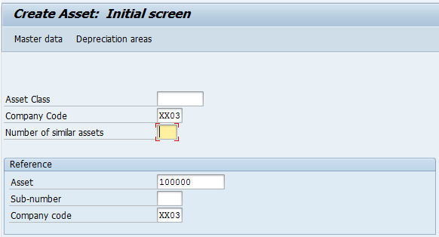
Master Data
Asset Master Data Creation:
1) Using Asset Class: Transaction Code AS01
2) Using a reference Asset: Transaction Code AS01

Slide 30
Depreciation Run
SAP supports the following direct types of depreciation: Ordinary Depreciation: Planned reduction in asset value due to normal wear and tear. Special Depreciation: Depreciation that is solely based on tax regulations. (E.g. Depreciation allowance under IT Act) Unplanned Depreciation: Depreciation resulting from unusual circumstances, such as damage to the asset, that lead to a permanent reduction in its value.

Slide 31
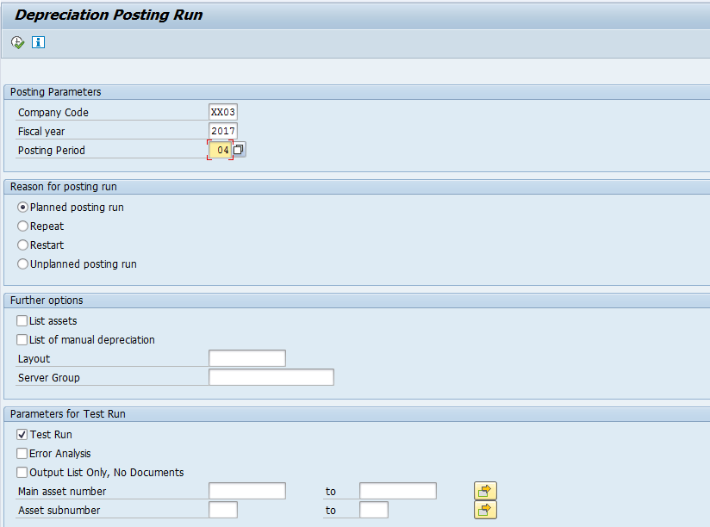
Depreciation Run
Planned Deprecation Run: AFAB

Slide 32
Asset Acquisitions
Acquisition with Vendor : Asset transaction integrated with Accounts Receivable or Accounts Payable (Without PO)
Fixed Assets
Vendor
1000
1000
Acquisition with MM-PO : Asset transaction posted from Materials Management (MM)
Fixed Assets
Vendor
1000
1000

Slide 33
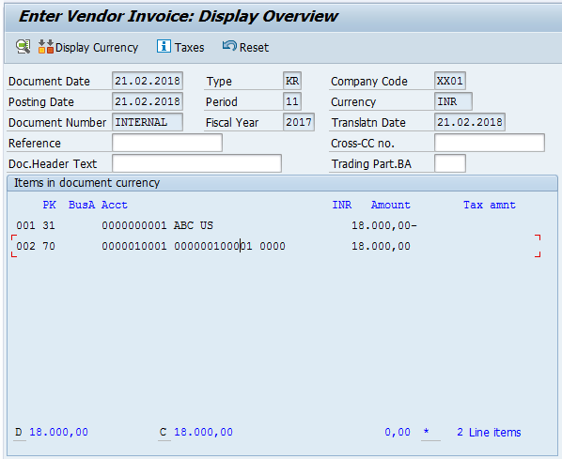
Asset Acquisitions
Acquisition with Vendor : F-90

Slide 34


Asset Transfer
1
2
A
B
Asset transfers can be one of the following scenarios:
Transfer within Company Code (ABUMN)
1. Transfer within same Company Code
E.g. From one asset class to another
Intercompany Transfer (ABT1N)
2. Inter-company transfers between companies in SAP
E.g. From one company to another

Slide 35
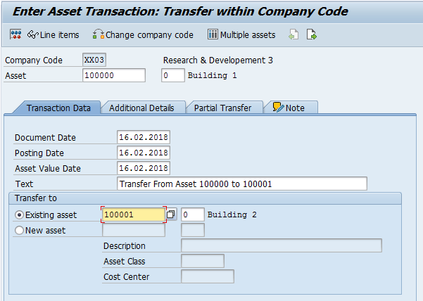
Transfer within Company Code (ABUMN)
Transfer within the same Company Code

Slide 36
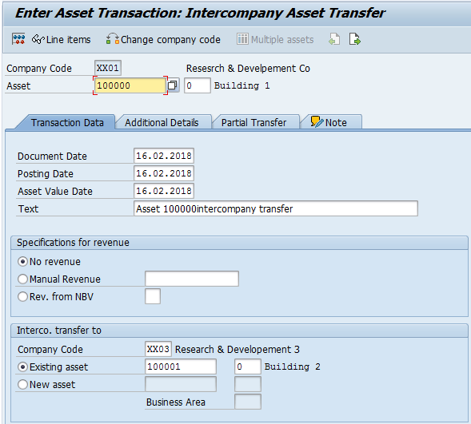
Intercompany Transfer (ABT1N)
Inter-company transfers between companies in SAP

Slide 37
Mukesh Kumar
Associate SAP FICO, Vertex consultant
Mukesh.kumar48@wipro.com
Notes:
Thank you slide
Thank You– font size 30, Arial Headings
Name & Designation – font size 18, Arial Headings
Your/contact email id – font size 18, Arial Headings

